Slide 1

ELIXIR BIOHACKATHON 2018
CF-Berges
No password
Opening and Welcome
Rafael C Jimenez and Victoria Dominguez Del Angel
November 12, 2018

Slide 2
ELIXIR BioHackathon 2018
We’re very excited to have you on board !
~150 registrations
19 Countries
92 % Public Research
5% Industries
29 Topics in Data, Interoperability, Tools and Training
Notes:
What
Goal
Priority

Slide 3

Notes:
What
Goal
Priority

Slide 4
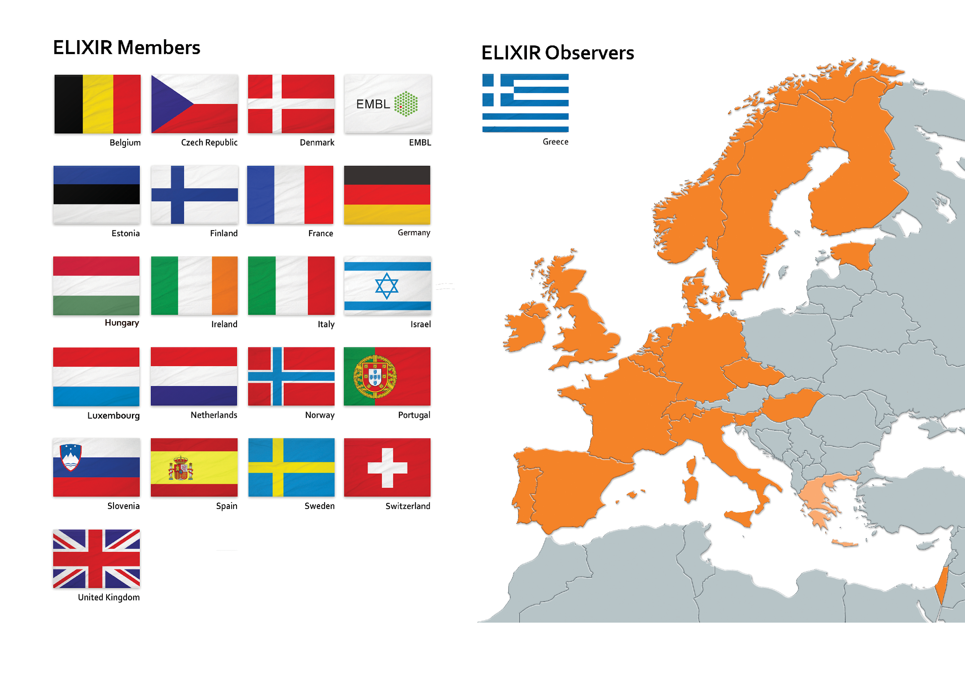
ELIXIR membership
Major bioinformatics service providers (~200) and supported by EU member states (22) & EMBL-EBI
Notes:
What
Goal
Priority

Slide 5
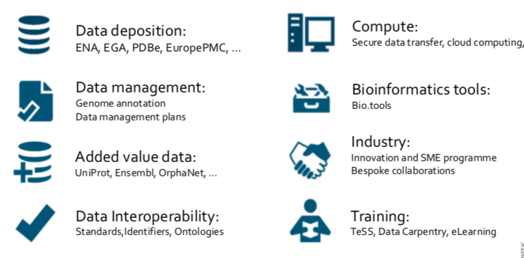
Elixir Services
Help scientists: Data sharing, linking data, sustainable research, connecting discipline, Better Science
http://www.elixir-europe.org/sites/default/files/documents/elixir_scientific_programme_final.pdf

Slide 6

Elixir France : Institut Français de Bioinformatique(IFB) IFB is a national hub and 33 nodes platforms belonging to the main French Research Organisations: CNRS, INRA, INRIA, INSERM, CEA, as well as CIRAD, the Pasteur and Curie Institutes and the French Universities. IFB mission is ensuring the quality, preservation and sustainability of French bioinformatics services (Tools, Compute, Training, and so on ) and to provide the access to the European community to a collection of unique resources directly produced by the French platforms.

Slide 7
Elixir France : Institut Français de Bioinformatique(IFB) Compute storage : 10 K CPU, 5 petabytes of storages. Federation: Clouds and Clusters
Tools: Workflows, VM and containers
Databases: Rare diseases, Plants and so on
Training : ~3.5 K trainees

Slide 8
BH’s Goals
Advance the development of an open-source infrastructure for data integration to accelerate scientific innovation
Engage the technical people in the bioinformatics community
Strengthen the interactions with ELIXIR Platforms and Communities

Slide 9
Projects
29 projects
11 topics
Text mining, Structured Metadata, Identifiers, Data Distribution, Data Integration, Validation, Containers, Tool Discovery, Visualisation, Workflows, Training Material
4 themes
Data, tools, interoperability and training
New ideas and projects are welcome
Create a new project folder and project page in GitHub
Let the Organising Committee bh2018paris@elixir-europe.org know

Slide 10
Plan
Meals
22:00
Socialiseathon
20:00
18:00
Symposium
16:00
Breaks
14:00
Hacking
12:00
Reporting
10:00
08:00
Mon
Tue
Wed
Thu
Fri

Slide 11
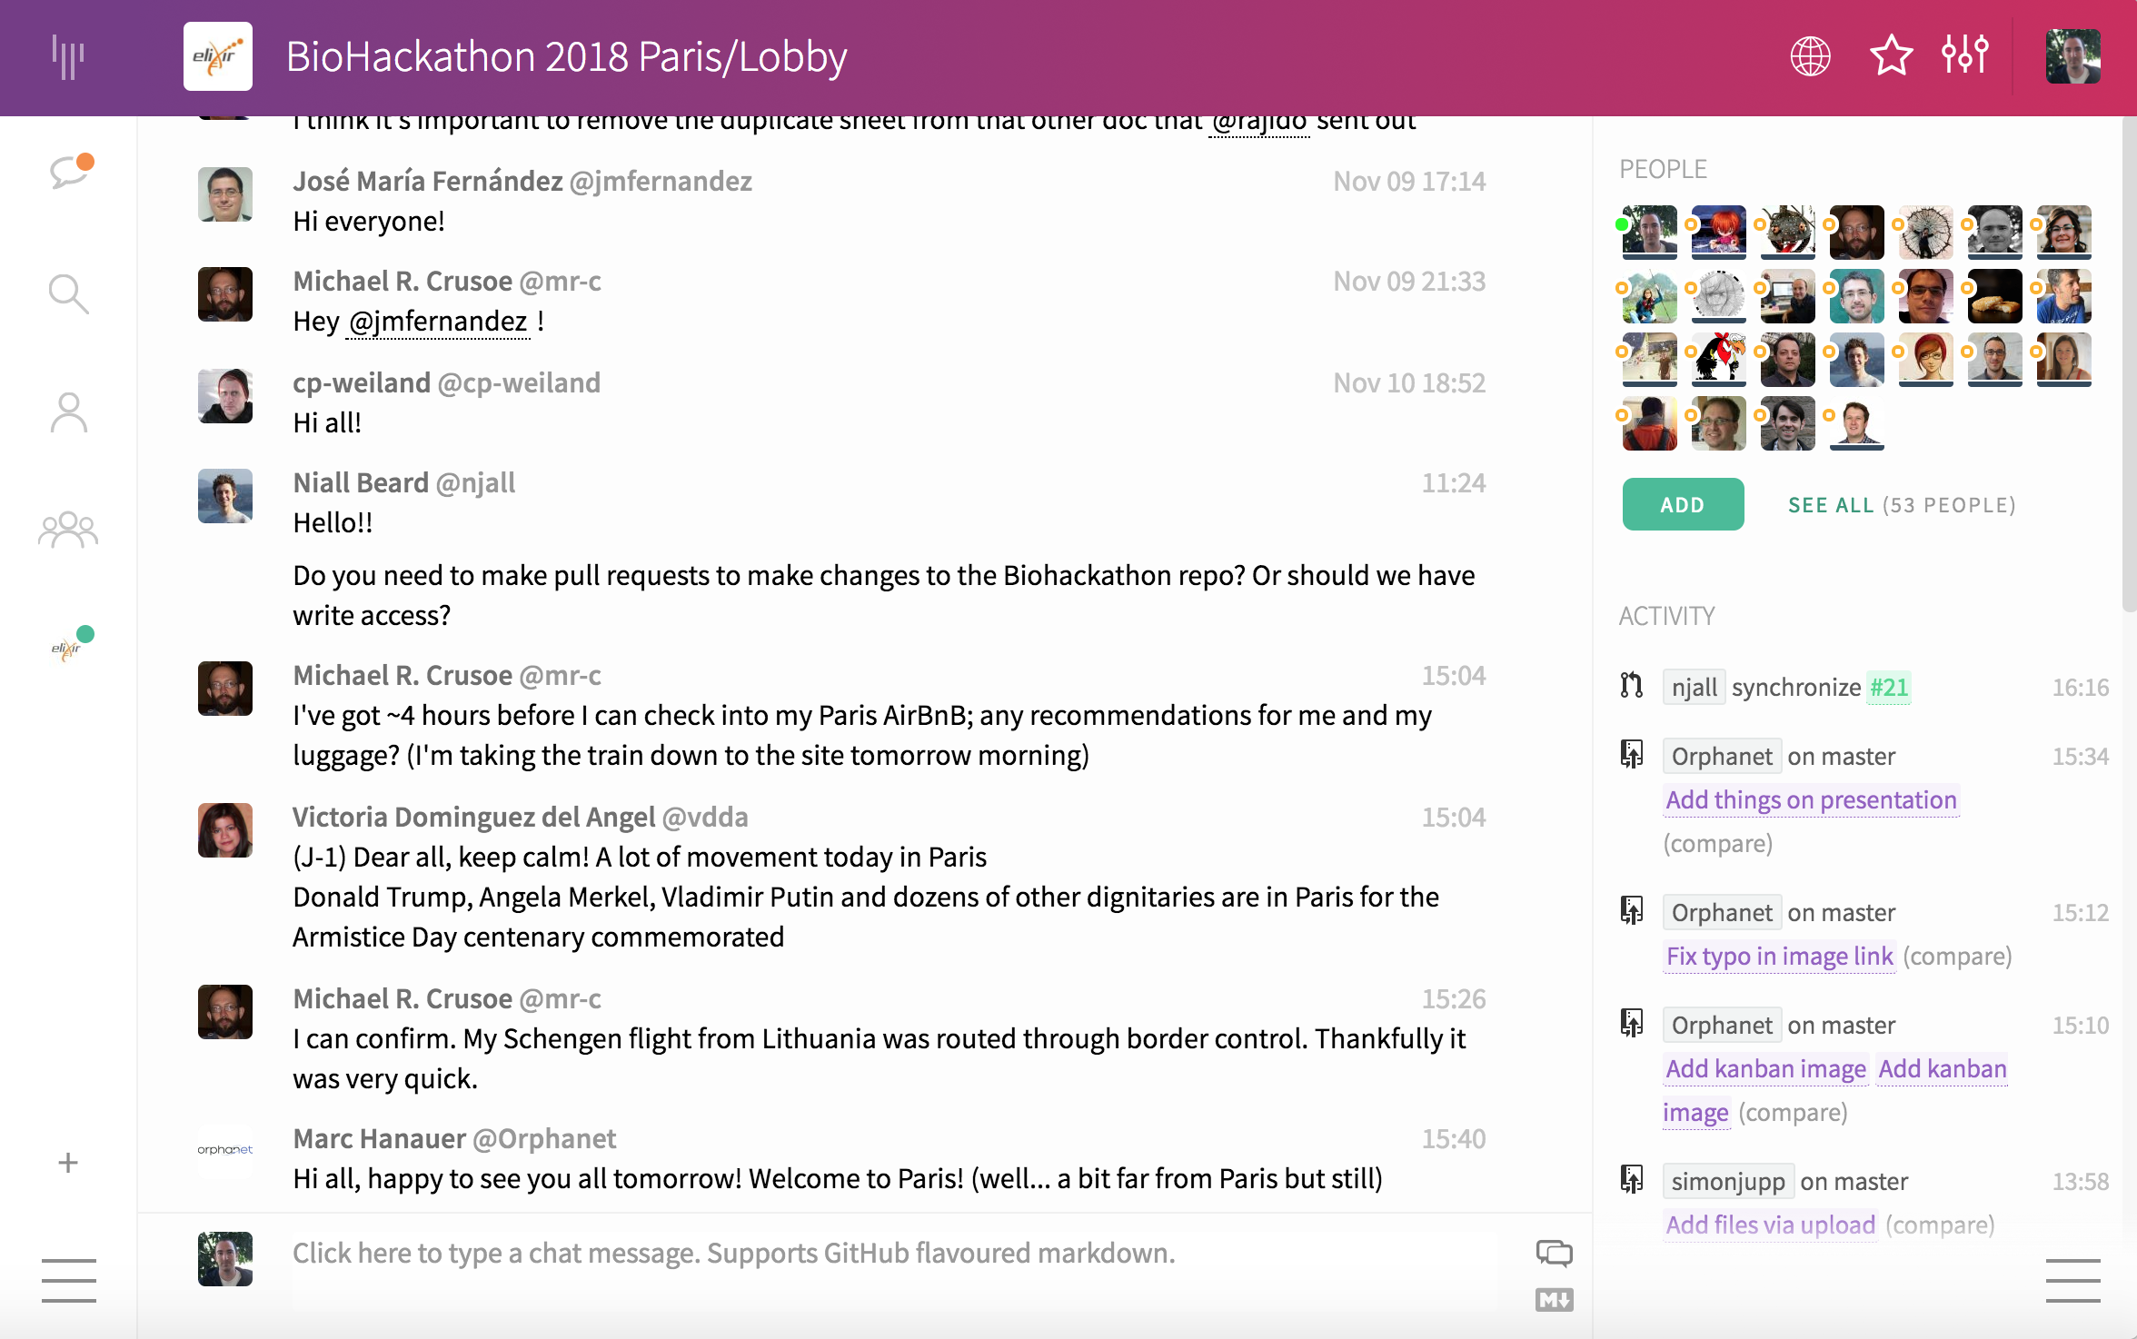

Gitter
https://gitter.im/bh2018paris/

Slide 12
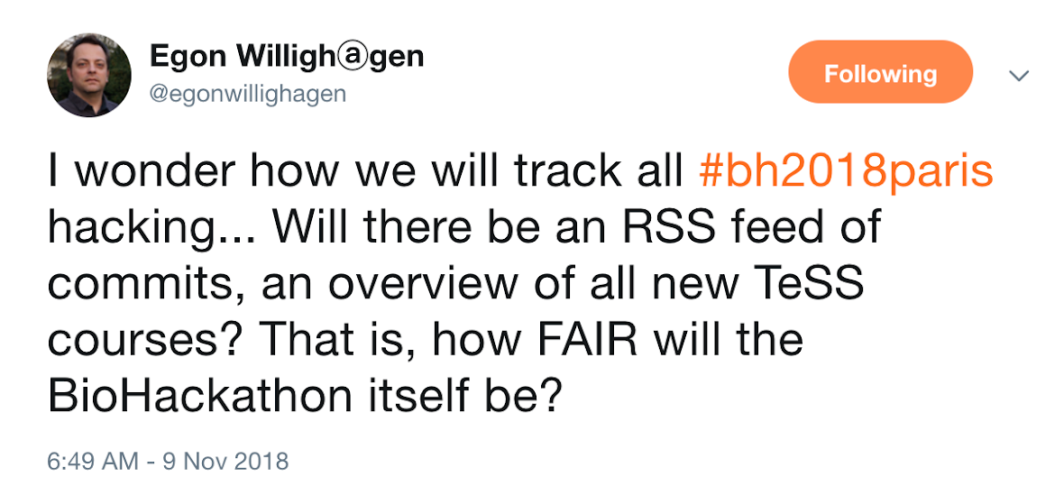
GitHub
https://github.com/elixir-europe/BioHackathon
Way to help people to track project activities and outcomes
Store anything useful related to the project
Keep project pages updated
If you are not yet a collaborator please ask a project lead or Ricardo arcila@ebi.ac.uk
All participants writing privileges
Project leads should have admin privileges

Slide 13
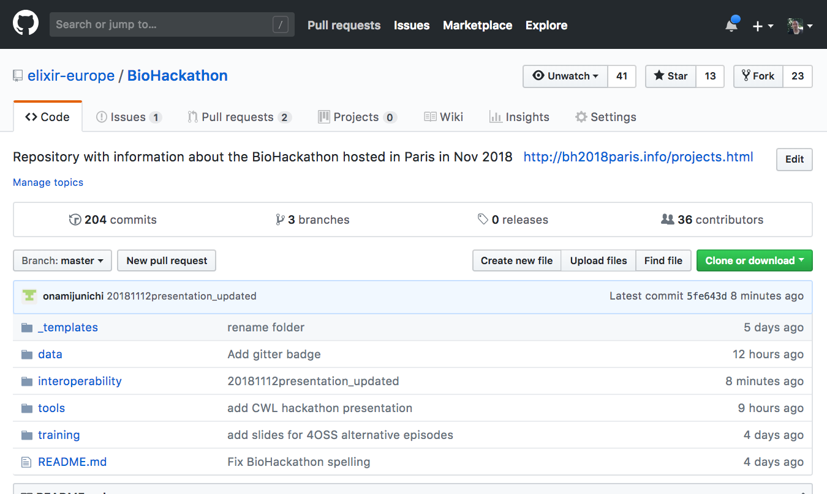
GitHub
https://github.com/elixir-europe/BioHackathon

Slide 14
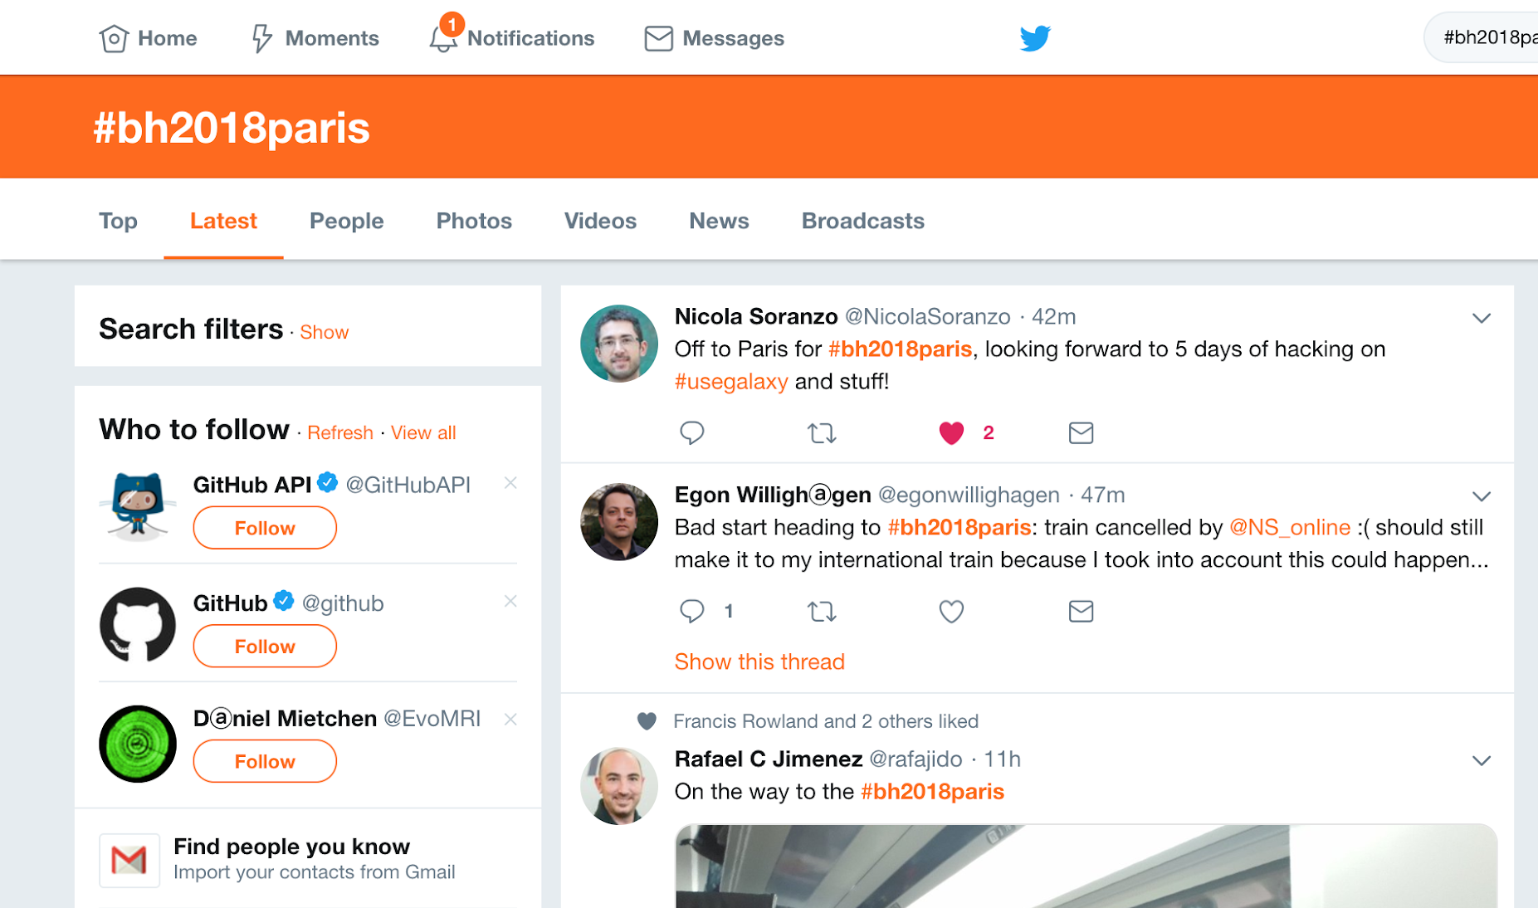
Twitter
#bh2018paris
@biohackathon

Slide 15
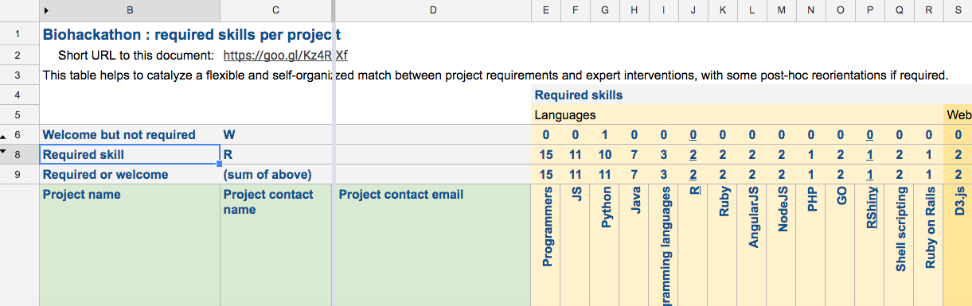
Finding people and skills
The skills of the participants and the skills required per project has compile in a spreadsheet https://goo.gl/Kz4RXf

Slide 16
Housekeeping
Claiming expenses
More information on Wednesday from 18:30 to 19:00 at the registration desk
Symposium
Coffee breaks
Use the landing next to the meeting room
Avoid using the bar after the stair
Lunch will be upstairs
Photos and video
We will take photos during the event
We will record the symposium presentations
If you do not want photos or recordings where you appear to to be public available please let us know at bh2018paris@elixir-europe.org

Slide 17
Acknowledgements
Project representatives
Hervé Ménager, Jacques van Helden, Jon Ison, Jun-ichi Onami, Leyla Garcia, Luca Cherubin, Manuel Bernal Llinares, Marc Hanauer, Mateusz Kuzak, Mustafa Anil Tuncel, Niall Beard, Noemi del Toro, Ola Tarkowska, Rabie Saidi, Simon Jupp, Stuart Owen, Toshiaki Katayama, Yasset Perez-Riverol, Yo Yehudi

Slide 18
Acknowledgements
Organising committee
Toshiaki Katayama | DBCLS | Advisor/Representative of the Japanese Biohackathon organising committee
Leyla J Garcia | EMBL-EBI | Advisor/Selection of hacking topics coordinator
Simon Jupp | EMBL-EBI | Advisor
Sirarat Sarntivijai | ELIXIR Hub | Advisor/Selection of hacking topics coordinator
Carole Goble | University of Manchester | Advisor
Chris Evelo | Maastricht University | Advisor
Marc Hanauer | INSERM | Advisor
Denis Thieffry | ENS | Advisor
Jacques van Helden | Aix-Marseille Université | Advisor
David Salgado | Aix-Marseille Université | Advisor
Ricardo Arcila | ELIXIR Hub | Website
Dana Cernoskova | ELIXIR Hub | Administration lead/Logistics and registration/

Slide 19






Acknowledgements
Supporting organisations

Slide 20
THANK YOU!

Slide 21
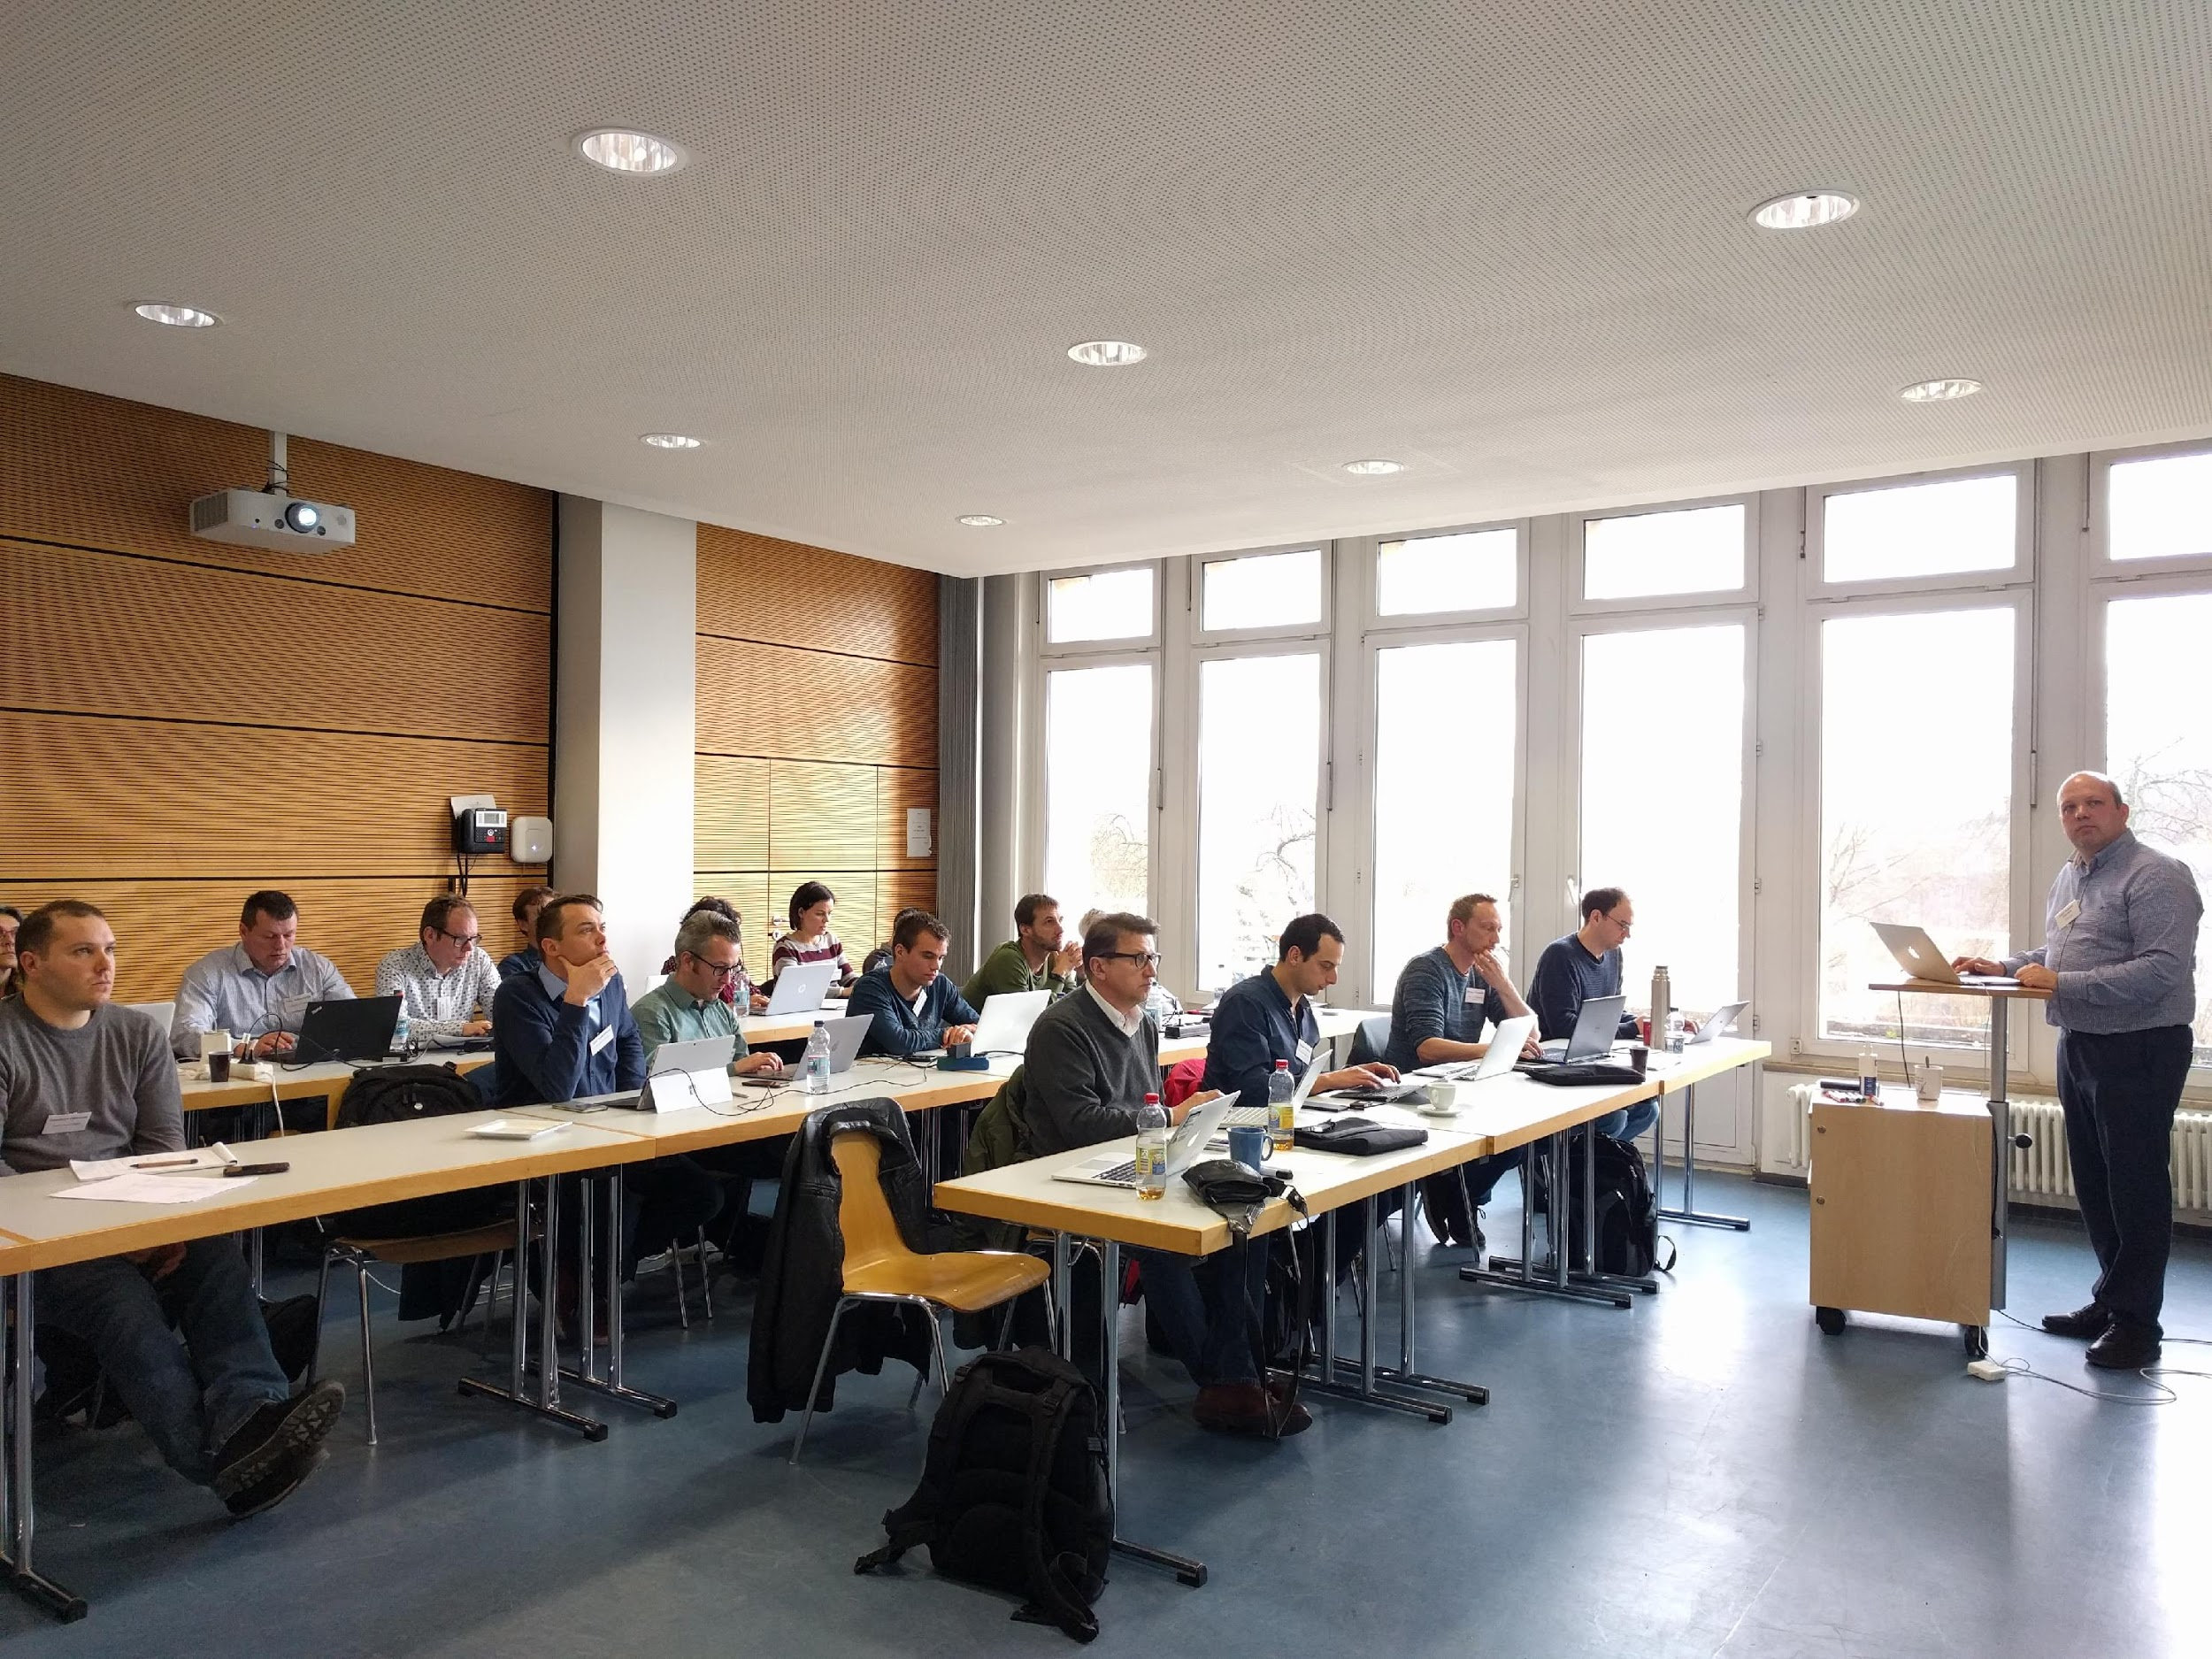
Presentation Topics

Slide 22
Symposium
12:00 - 13:00 | Registration and Lunch | BH participatns
13:00 - 13:10 | Opening and welcome | The Organising Committee
13:10 - 14:20 | Text mining Structured Metadata | Data Interoperability
14:20 - 14:50 | COFFEE BREAK
14:50 - 16:40 | Identifiers Data Distribution Data Integration Validation | Interoperability
16:40 – 17:00 | Containers Tool Discovery | Tools
17:00 - 17:30 | COFFEE BREAK
17:30 - 18:30 | Visualisation Workflows | Tools
18:30 - 19:00 | Training Material | Training

Slide 23
Programme
NOV 13 -15 07:00 - 09:00 | Breakfast
09:00 - 11:30 | Hack
11:30 - 12:00 | Hack
12:00 - 13:00 | Lunch
13:00 - 19:00 | Hack
19:00 - 20:00 | Dinner
20:00 - 24:00 | Socialisethon
NOV 16 07:00 - 09:00 | Breakfast
09:00 - 11:30 | Hack
11:30 - 12:00 | Report
12:00 - 13:00 | Lunch
13:00 - 14:30 | Writethon

